Slide 1
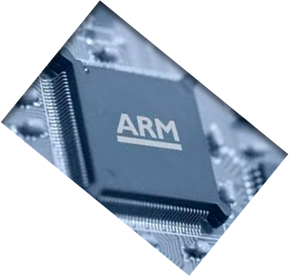

MICROPROCESSOR AND COMPUTER ARCHITECTURE
CONTROL HAZARDS
Credits:
MPCA Team

Slide 2
CC1
CC2
CC3
CC4
CC5
CC6
CC7
CC8
beq R2, R1, here
IM
Reg
ALU
DM
Reg
Solution?
(S/W or H/W)
add ...
IM
Reg
ALU
DM
Reg
sub ...
IM
Reg
ALU
DM
Reg
These instructions
shouldn’t be executed!
IM
Reg
ALU
DM
Reg
here: ldr ...
IM
Reg
ALU
DM
Finally, the right instruction

Slide 3
CONTROL HAZARDS
When the flow of instruction addresses is not sequential (i.e., PC = PC + 4); incurred by change of flow instructions
  Conditional branches ( beq , bne)
  Unconditional branches ( b, bal)
  Exceptions
  Control hazards occur less frequently than data hazards, but there is nothing as effective against control hazards as forwarding is for data hazards

Slide 4
CONTROL HAZARDS
Branch Instruction | IF | ID | EX | MEM | WB
Branch Successor |  | IF | stall | stall | IF | ID | EX | MEM | WB
Branch Successor +1 |  |  |  |  |  | IF | ID | EX | MEM | WB
Branch Successor +2 |  |  |  |  |  |  | IF | ID | EX | MEM
A branch causes three cycle stall in our example processor pipeline
  One cycle is a repeated IF – necessary if the branch would be taken. If the branch is not taken, this IF is redundant
  Two idle cycles

Slide 5
SOLUTION
Software
  Insert no-ops (Not preferred)
  Delayed branching.
Hardware
  Stall cycles (not preferred) (Impacts CPI)
  Move decision point as early in the pipeline as possible, thereby reducing the number of stall cycles
  Guess..
    Static prediction: based on instruction type
    Dynamic prediction: based on execution history

Slide 6
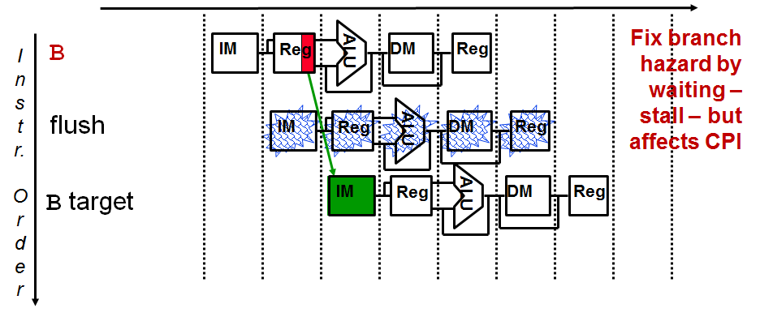
BRANCH INCUR ONE STALL
Branch not decoded until ID, so one flush is needed
Fortunately, branches are very infrequent.
Notes:
Fortunately, jumps are very infrequent – less that 2% of the SPECint instructions and x% of the SPECfp ones.

Slide 7
TWO “TYPES” OF STALLS
noop instruction (or bubble) inserted between two instructions in the pipeline (as done for load-use situations)
  Keep the instructions earlier in the pipeline (later in the code) from progressing down the pipeline for a cycle (“bounce” them in place with write control signals)
  Insert noop by zeroing control bits in the pipeline register at the appropriate stage
  Let the instructions later in the pipeline (earlier in the code) progress normally down the pipeline

Slide 8
TWO “TYPES” OF STALLS
Flushes (or instruction squashing) were an instruction in the pipeline is replaced with a noop instruction (as done for instructions located sequentially after b instructions)
  Zero the control bits for the instruction to be flushed

Slide 9
When Branches are resolved?
Most of the work is done in EX stage..
  Branch address computation, PC updation
  Rm & Rn compare and set zero flag accordingly
This leads to:
  Decision is needed by second cycle
  But, the decision is effective by MEM stage
Feb 07-08 & 10, 2020
Dr. TSB Sudarshan

Slide 10
Stall Cycles
CC1
CC2
CC3
CC4
CC5
CC6
CC7
CC8
beq R4, R0, here
IM
Reg
DM
Reg
and R12, R2, R5
Bubble
Bubble
IM
Reg
DM
Reg
or ...
IM
Reg
DM
Reg
add ...
IM
Reg
DM
str ...
IM
Reg
All branches waste 2 cycles irrespective of whether branch is taken or not.
Wasting clock cycles
Better way???
Reduce stall cycles
  Guess or Predict
Feb 07-08 & 10, 2020
Dr. TSB Sudarshan

Slide 11
MOVING BRANCH DECISIONS EARLIER IN PIPE
Move the branch decision hardware back to the EX stage
  Reduces the number of stall (flush) cycles to two
Add hardware to compute the branch target address and evaluate the branch decision to the ID stage
  Reduces the number of stall (flush) cycles to one (like with branches)
    But now need to add forwarding hardware in ID stage
  Computing branch target address can be done in parallel with RegFile read (done for all instructions – only used when needed)
  Comparing the registers can’t be done until after RegFile read, so comparing and updating the PC adds a mux, a comparator, and an and gate to the ID timing path
For deeper pipelines, branch decision points can be even later in the pipeline, incurring more stalls
Notes:
Want a small branch penalty.
Need more forwarding and hazard detection hardware for second option (one stall implementation) since a branch depended on a result still in the pipeline (that is one of the source operands for the comparison logic) must be forwarded from the EX/MEM or MEM/WB pipeline latches.

Slide 12
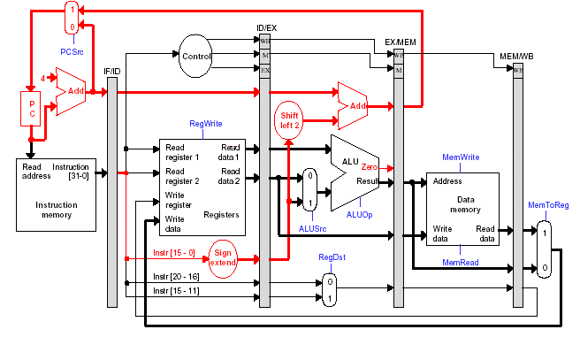
Reduce Stall Cycles
By moving updating of PC from EX to ID???
Branch Delay = 1 cycle
Feb 07-08 & 10, 2020
Dr. TSB Sudarshan

Slide 13
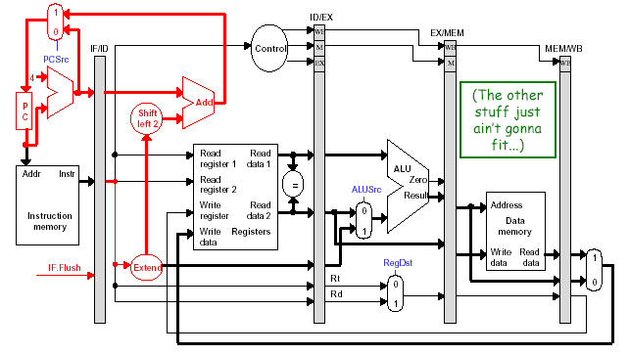
Reduce Stall Cycles
By moving updating of PC from EX to ID???
Branch Delay = 1 cycle
Feb 07-08 & 10, 2020
Dr. TSB Sudarshan

Slide 14
Branch decision at ID stage
CC1
CC2
CC3
CC4
CC5
CC6
CC7
CC8
beq R4, R0, here
IM
Reg
DM
Reg
and R12, R2, R5
Bubble
IM
Reg
DM
Reg
or ...
IM
Reg
DM
Reg
add ...
IM
Reg
DM
str ...
IM
Reg
Can we reduce it further by moving the updating of PC from ID to IF???
NO
Feb 07-08 & 10, 2020
Dr. TSB Sudarshan

Slide 15
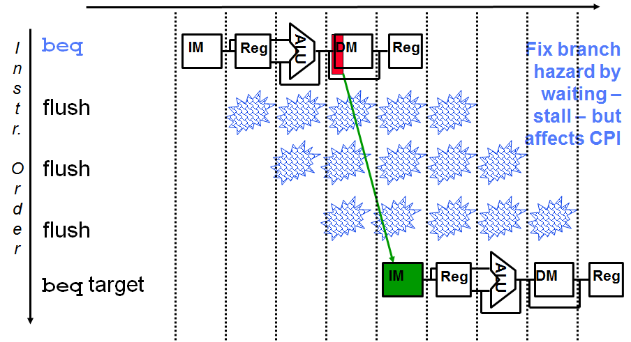
REVIEW: BRANCHES INCUR THREE STALLS
Notes:
Another “solution” is to put in enough extra hardware so that we can test registers, calculate the branch address, and update the PC during the second stage of the pipeline. That would reduce the number of stalls to only one.
A third approach is to prediction to handle branches, e.g., always predict that branches will be untaken. When right, the pipeline proceeds at full speed. When wrong, have to stall (and make sure nothing completes – changes machine state – that shouldn’t have). Will talk about these options in more detail in next,next lecture.

Slide 16
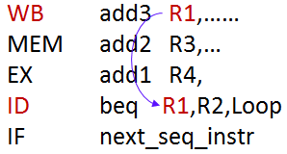
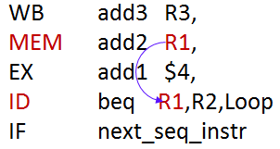
ID BRANCH FORWARDING ISSUES
MEM/WB “forwarding” is taken care of by the normal RegFile write before read operation
Need to forward from the EX/MEM pipeline stage to the ID comparison hardware for cases like
if (IDcontrol.Branch
and (EX/MEM.RegisterRd != 0)
and (EX/MEM.RegisterRd = IF/ID.RegisterRs))
ForwardC = 1
if (IDcontrol.Branch
and (EX/MEM.RegisterRd != 0)
and (EX/MEM.RegisterRd = IF/ID.RegisterRt))
ForwardD = 1

Slide 17
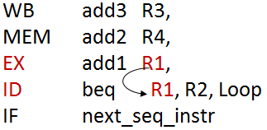
ID BRANCH FORWARDING ISSUES, CONTD..
If the instruction immediately before the branch produces one of the branch source operands, then a stall needs to be inserted (between the beq and add1) since the EX stage ALU operation is occurring at the same time as the ID stage branch compare operation
  “Bounce” the beq (in ID) and next_seq_instr (in IF) in place (ID Hazard Unit deasserts PC.Write and IF/ID.Write)
  Insert a stall between the add in the EX stage and the beq in the ID stage by zeroing the control bits going into the ID/EX pipeline register (done by the ID Hazard Unit)
If the branch is found to be taken, then flush the instruction currently in IF (IF.Flush)

Slide 18

Example
Assume the following instruction mix:
Type Frequency
Arith/Logic 40%
Load 30% of which 25% are followed immediately by
an instruction using the loaded value
Store 10%
branch 20% of which 45% are taken
What is the resulting CPI for the pipelined processor with forwarding and branch address calculation in ID stage?
CPI = Ideal CPI + Pipeline stall clock cycles per instruction
= 1 + stalls by loads + stalls by branches
= 1 + .3x.25x1 + .2 x .45x1
= 1 + .075 + .09
= 1.165

Slide 19
DELAYED DECISION
If the branch hardware has been moved to the ID stage, then we can eliminate all branch stalls with delayed branches which are defined as instructions, that always get executed, it is the next sequential instruction after the branch instruction – the branch takes effect after that next instruction
  MIPS compiler moves an instruction to immediately after the branch that is not affected by the branch (a safe instruction) thereby hiding the branch delay
With deeper pipelines, the branch delay grows requiring more than one delay slot
  Delayed branches have lost popularity compared to more expensive but more flexible (dynamic) hardware branch prediction
  Growth in available transistors has made hardware branch prediction relatively cheaper
Notes:
No processor uses delayed branches of more than 1 cycl.
For longer branch delays, hardware-base branch prediction is used.

Slide 20
Delayed Branching
Similar to insert no-ops
Compiler inserts….??
Used to eliminate branch stalls
Instruction after branch is known as delay slot
Instruction in delay slot is always executed
Fill the slots with useful instructions
Feb 07-08 & 10, 2020
Dr. TSB Sudarshan

Slide 21
Delay Slot
CC1
CC2
CC3
CC4
CC5
CC6
CC7
CC8
beq R4, R0, there
IM
Reg
DM
Reg
and R12, R2, R5
IM
Reg
DM
Reg
there: orr ...
IM
Reg
DM
Reg
add ...
IM
Reg
DM
str ...
IM
Reg
Branch delay slot instruction (next instruction after a branch) is
executed even if the branch is taken.
Feb 07-08 & 10, 2020
Dr. TSB Sudarshan

Slide 22
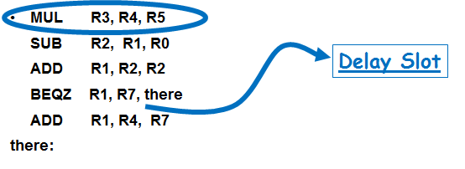
Filling the delay slot
In case, the compiler is not able to find suitable instruction, then
MUL R3, R4, R5
SUB R2, R1, R0
ADD R1, R2, R2
BEQZ R1, R7, there
NOP
ADD R1, R4, R7
there:
SUB R2, R1, R0
ADD R1, R2, R2
BEQZ R1, R7, there
MUL R3, R4, R5
ADD R1, R4, R7
there:
Feb 07-08 & 10, 2020

Slide 23
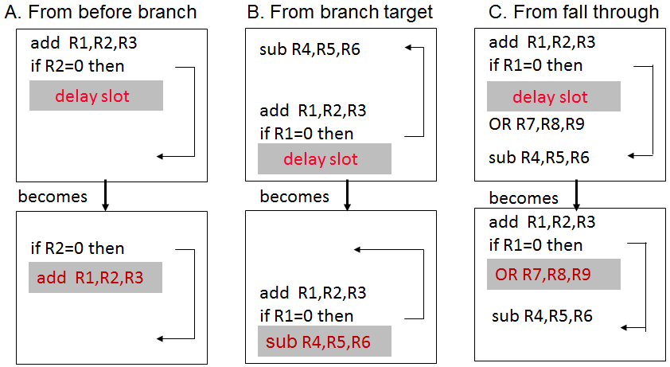
SCHEDULING BRANCH DELAY SLOTS
A is the best choice, fills delay slot and reduces IC
In B and C, the sub instruction may need to be copied, increasing IC
In B and C, must be okay to execute sub when branch fails
Notes:
Limitations on delayed-branch scheduling come from 1) restrictions on the instructions that can be moved/copied into the delay slot and 2) limited ability to predict at compile time whether a branch is likely to be taken or not.
In B and C, the use of R1 prevents the add instruction from being moved to the delay slot
In B the sub may need to be copied because it could be reached by another path. B is preferred when the branch is taken with high probability (such as loop branches

Slide 24
Branch Prediction
Guessing the branch
  One of the important problems in “Computer Architecture”
  Static: prediction by compiler
  Dynamic: prediction by hardware
Static Prediction
  Always Not Taken (easiest)
  Always Taken
  Taken / Not taken
Dynamic Prediction
  1- bit
  2-bit
  others

Slide 25
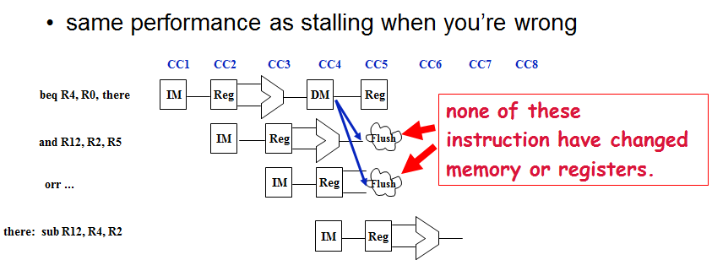
Predict Always Not Taken
Misprediction leads to wastage of 2 cycles. Better than stalling.
If prediction is true save 2 cycles
Depends on pipeline structure: Longer pipeline:
more instructions flushed
    more time wasted
    lower performance

Slide 26
Static Branch Prediction
Examination of program behavior
Predict on basis of branch direction
forward : Not taken
backward : Taken
use of profile information collected from earlier run of program

Slide 27
Other Static Prediction Strategies
Assume backwards branch is always taken, forward branch never is
  “backwards” = negative displacement field
  loops (which branch backwards) are usually executed multiple times.
  “if-then-else” often takes the “then” (no branch) clause.
Compiler makes educated guess
  sets “predict taken/not taken” bit in instruction

Slide 28
Static prediction options
predict always not-taken
+ very simple, since we already know the target (PC+4)
- majority of branches (~65%) are taken
predict always taken
+ better performance
- more difficult, must know target before branch is decoded
predict backward taken
  most backward branches are taken
predict specific opcodes taken
use profiles to predict on per-static branch basis
  pretty good

Slide 29
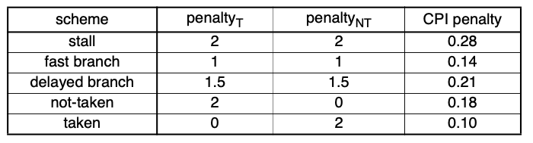
Performance Example:
CPI-penalty = %branch * [(%_{T} * penalty_{T}) + (%_{NT} * penalty_{NT})]
simple branch statistics
• 14% “branches”
• 65% of branches are “taken”

Slide 30
DYNAMIC BRANCH PREDICTION
Dynamic branch prediction keeps a brief history of what happened at each branch

Slide 31
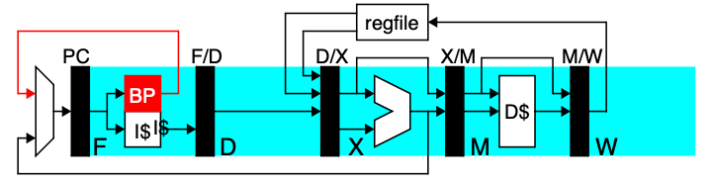
hardware (BP) guesses whether and where a branch will go
0x64 bnez r1,#10
0x74 add r3,r2,r1
start with branch PC (0x64) and produce
  direction (Taken)
  direction + target PC (0x74)
  direction + target PC + target instruction (add r3, r2,r1)

Slide 32
One-bit Predictor
Simplest method:
  A branch prediction buffer or Branch History Table (BHT) indexed by low address bits of the branch instruction.
  Each buffer location (or BHT entry) contains one bit indicating whether the branch was recently taken or not.
  Change bit on misprediction
  Always mispredicts in first and last loop iterations.

Slide 33
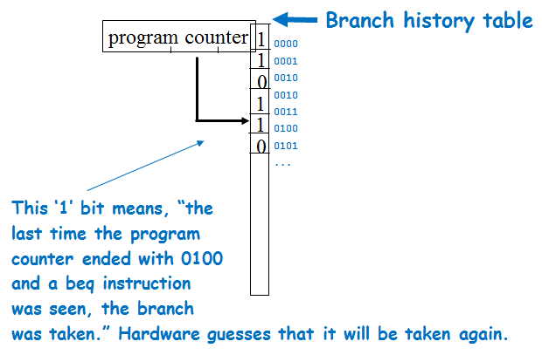
One-bit Predictor
for (i=0;i<10;i++)
{
...
...
}
...
...
adds r3, r3, r4
beq r3, r5, loop

Slide 34
One-bit Predictor
Shortcomings with loops
  always mispredicts twice for every loop
    Mispredicts upon exiting a loop, since this is a surprise
    If we repeat the loop, we’ll miss again since we’ll predict branch not taken
for (i=0;i<10;i++)
{
...
...
}
...
...
adds r3, r3, r4. ; r3 = i, r4=1
beq r3, r5, loop. ; r5 = 10

Slide 35
Simple and Effective, But…
Aliasing Problem
  branches with same lower order bits will reference the same entry, causing mutual prediction
Shortcomings with loops
  always mispredicts twice for every loop
    Mispredicts upon exiting a loop, since this is a surprise
    If we repeat the loop, we’ll miss again since we’ll predict, branch not taken

Slide 36
Prediction Accuracy
Assume the branch is executed 10 times and its part of another loop which executes 5 times.
What is the prediction accuracy with 1-bit predictor?

Slide 37
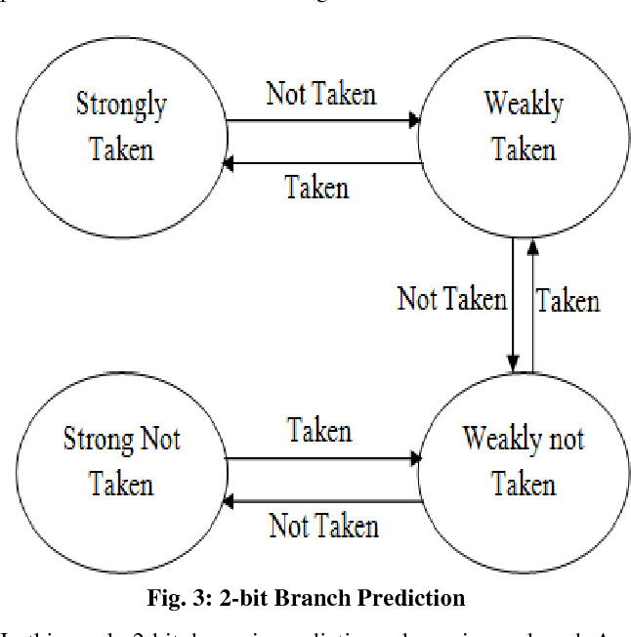
Two-bit Predictor

Slide 38
DEALING WITH EXCEPTIONS
Exceptions (aka interrupts) are just another form of control hazard.
Exceptions arise from
  Arithmetic overflow
  Trying to execute an undefined instruction
  An I/O device request
  An OS service request (e.g., a page fault, TLB exception)
  A hardware malfunction
Notes:
For undefined instrs, hardware failure, or arith overflow – the OS normally kills the program and returns an indication of the reason to the user
For an I/O device request or an OS service call – the OS saves the state of the program, performs the desired task and, at some point in the future, restores the program to continue execution

Slide 39
DEALING WITH EXCEPTIONS
The pipeline has to stop executing the offending instruction in midstream, let all prior instructions complete, flush all following instructions, set a register to show the cause of the exception, save the address of the offending instruction, and then jump to a prearranged address (the address of the exception handler code)
The software (OS) looks at the cause of the exception and “deals” with it
Notes:
For undefined instrs, hardware failure, or arith overflow – the OS normally kills the program and returns an indication of the reason to the user
For an I/O device request or an OS service call – the OS saves the state of the program, performs the desired task and, at some point in the future, restores the program to continue execution

Slide 40
TWO TYPES OF EXCEPTIONS
Interrupts – asynchronous to program execution
  caused by external events
  may be handled between instructions, so can let the instructions currently active in the pipeline complete before passing control to the OS interrupt handler
  simply suspend and resume user program

Slide 41
TWO TYPES OF EXCEPTIONS
Traps (Exception) – synchronous to program execution
  caused by internal events
  condition must be remedied by the trap handler for that instruction, so much stop the offending instruction midstream in the pipeline and pass control to the OS trap handler
  the offending instruction may be retried (or simulated by the OS) and the program may continue or it may be aborted

Slide 42
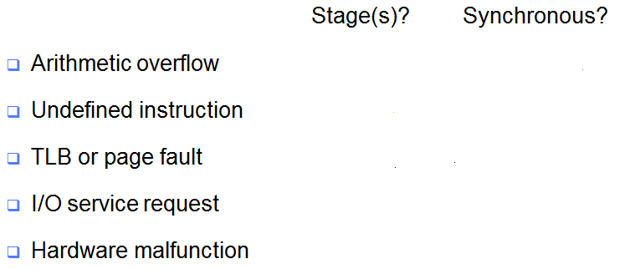
WHERE IN THE PIPELINE EXCEPTIONS OCCUR
IM
Reg
ALU
DM
Reg
Notes:
For class handout

Slide 43
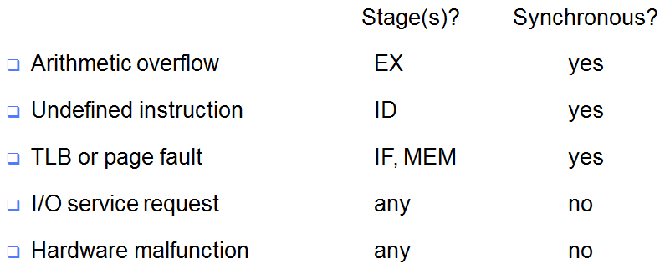
WHERE IN THE PIPELINE EXCEPTIONS OCCUR
IM
Reg
ALU
DM
Reg
Beware that multiple exceptions can occur simultaneously in a single clock cycle
Notes:
For lecture
Note that an I/O service request is not associated with any executing instruction so can be handled when the hardware decides (to some limit) –i.e., pick the most convenient place to handle the exception

Slide 44
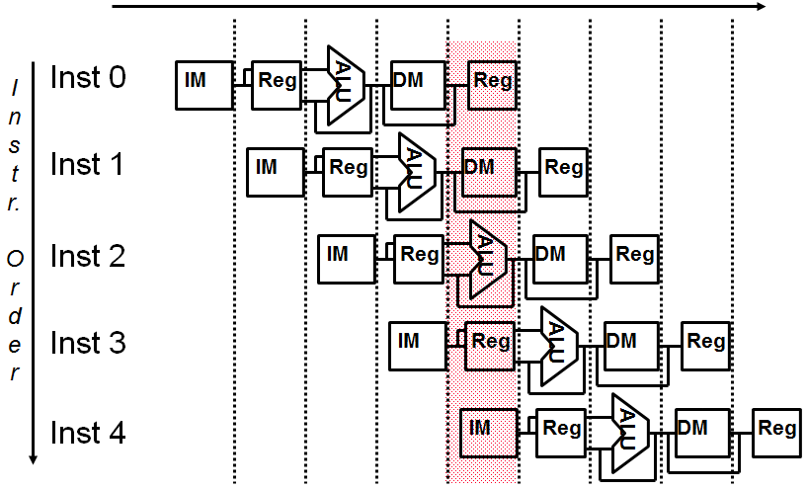
MULTIPLE SIMULTANEOUS EXCEPTIONS
Hardware sorts the exceptions so that the earliest instruction is the one interrupted first
Notes:
For class handout

Slide 45
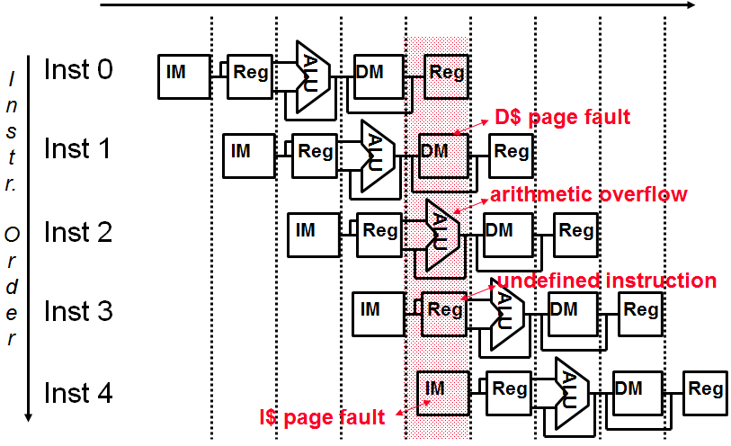
MULTIPLE SIMULTANEOUS EXCEPTIONS
Hardware sorts the exceptions so that the earliest instruction is the one interrupted first
Notes:
For lecture

Slide 46
SUMMARY
All modern day processors use pipelining for performance (a CPI of 1 and fast a CC)
Pipeline clock rate limited by slowest pipeline stage – so designing a balanced pipeline is important

Slide 47
SUMMARY
Must detect and resolve hazards
  Structural hazards – resolved by designing the pipeline correctly
  Data hazards
    Stall (impacts CPI)
    Forwarding (requires hardware support)
  Control hazards – put the branch decision hardware in as early a stage in the pipeline as possible
    Stall (impacts CPI)
    Delay decision (requires compiler support)
    Static and dynamic prediction (requires hardware support)

Slide 48
Q & A
Control Hazards
Notes:
Feb 3, 2020

